Slide 1
EES203: Geochemistry
Instructor: Anoop Ambili
Email id: anoop@iisermohali.ac.in

Slide 2
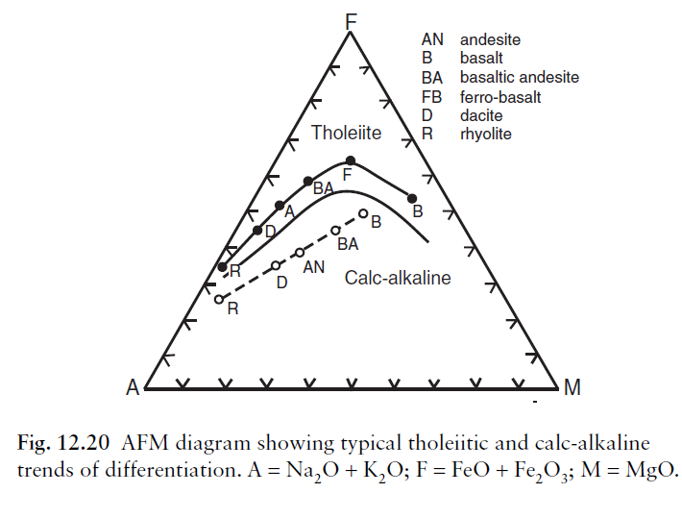
Classification of primary basaltic magma

Slide 3
Elemental partioning during magmatic differentiation

Slide 4
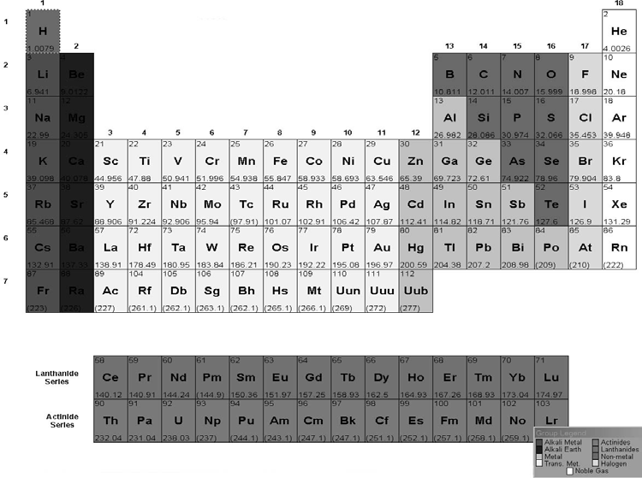
Rare earth elements

Slide 5
Contrasts and similarities in the D values: All are incompatible
Also Note:
HREE are less incompatible
Especially in garnet
Eu can 2+ which conc. in plagioclase
Table 9-1. Partition Coefficients for some commonly used trace elem ents in bas altic and andes itic rocks
 |  |  | Olivine Opx | Cpx | Garnet | Plag Amph
 | Rb |  | 0.006 0.02 0.01 0.01 0.006 0.12 14 5 2.1 10 0.007 0.02 0.009 0.02 0.009 0.05 0.009 0.05 0.008 0.05 0.01 0.05 0.013 0.31 0.014 0.34 0.016 0.11 | 0.04 0.14 0.07 2.6 8.4 0.08 0.34 0.6 0.9 0.9 1 1 0.2 0.82 | 0.001 0.001 0.002 0.4 0.17 0.05 0.05 0.07 0.06 0.9 5.6 18 30 35 | 0.1 0.3 1.8 0.57 0.23 0.31 0.01 3 10 1.6 0.14 0.27 0.14 0.34 0.08 0.19 0.08 0.91 0.1/1.5* 1.01 0.03 1.4 0.08 0.48 0.07 0.97 0.08 0.89
 | Sr
 | Ba
 | Ni
 | Cr
 | La | Rare Earth Elements
 | Ce
 | Nd
 | Sm
 | Eu
 | Tb
 | Er
 | Yb
 | Lu
 | data f rom Henderson (1982) |  |  | * Eu³⁺/Eu²⁺ |  | Italics are estimated
5

Slide 6
REE Diagrams Plots of concentration as the ordinate (y-axis) against increasing atomic number ✦ Degree of compatibility increases from left to right across the diagram
Concentration
La Ce Nd Sm Eu Tb Er Dy Yb Lu
Source: Chemical Petrology II: Trace Elements (Principles of Igneous and Metamorphic Petrology John D. Winter)

Slide 7
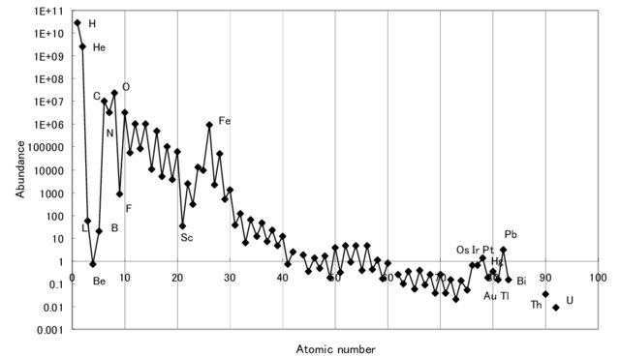
REE Diagrams
✦ Eliminate Oddo-Harkins effect and make y-scale more functional by normalizing to a standard
▲ estimates of primordial mantle REE
▲ chondrite meteorite concentrations

Slide 8
Comparison of REE in a Kilauea lava with Chondrite abundances (data in ppm )
 | REE | Chondrite | Kilauea | Kilauea/Chondrite | Divide sample by chondritic abundance
 | La | 0.31 | 9.05 | 29.19
 | Ce | 0.808 | 22.4 | 27.72
 | Pr | 0.122 | 3.09 | 25.33
 | Nd | 0.600 | 15.6 | 26.00
 | Sm | 0.195 | 4.02 | 20.61
 | Eu | 0.0735 | 1.40 | 19.04
 | Gd | 0.259 | 4.36 | 16.83
 | Tb | 0.0474 | 0.72 | 15.19
 | Dy | 0.322 | 3.93 | 12.20
 | Ho | 0.0718 | 0.77 | 10.72
 | Er | 0.210 | 1.91 | 9.095
 | Yb | 0.209 | 1.58 | 7.55
 | Lu | 0.0322 | 0.22 | 6.83

Slide 9
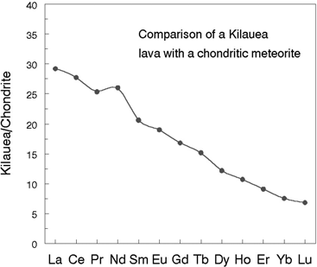
Comparison of REE in a Kilauea lava with Chondrite abundances (data in ppm )
Plot of preceding Kilauea data.

Slide 10
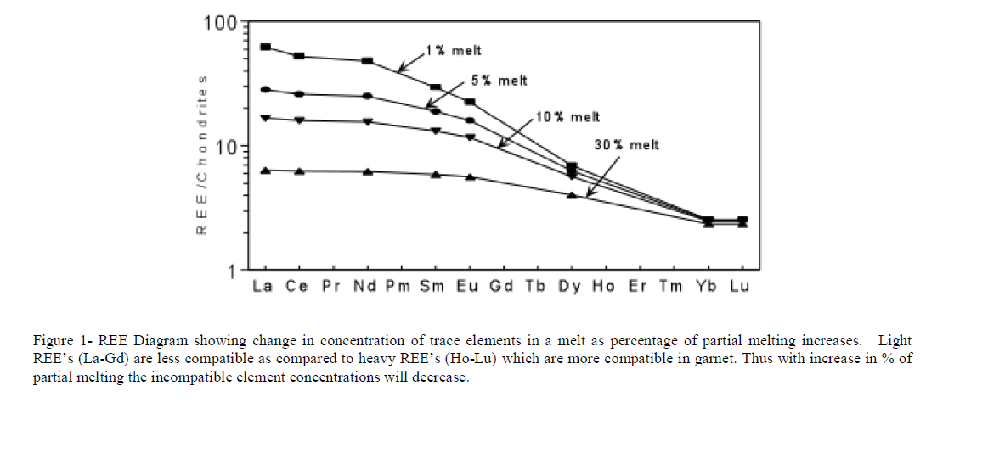

Slide 11
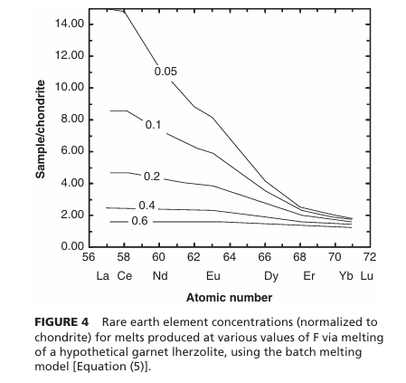
Source: Chemical Petrology II: Trace Elements (Principles of Igneous and Metamorphic Petrology John D. Winter)

Slide 12
Batch Melting
The melt remains resident until at some point it is released and moves upward
Equilibrium melting process with variable % melting
Source: Chemical Petrology II: Trace Elements (Principles of Igneous and Metamorphic Petrology John D. Winter)

Slide 13
Batch Melting
C_{L} = trace element concentration in the liquid
C_{O} = trace element concentration in the original rock before melting began
F = wt fraction of melt produced = melt/(melt + rock)
C
1
L
=
C
D_{i}
(1
−
F)
+
F
O

Slide 14
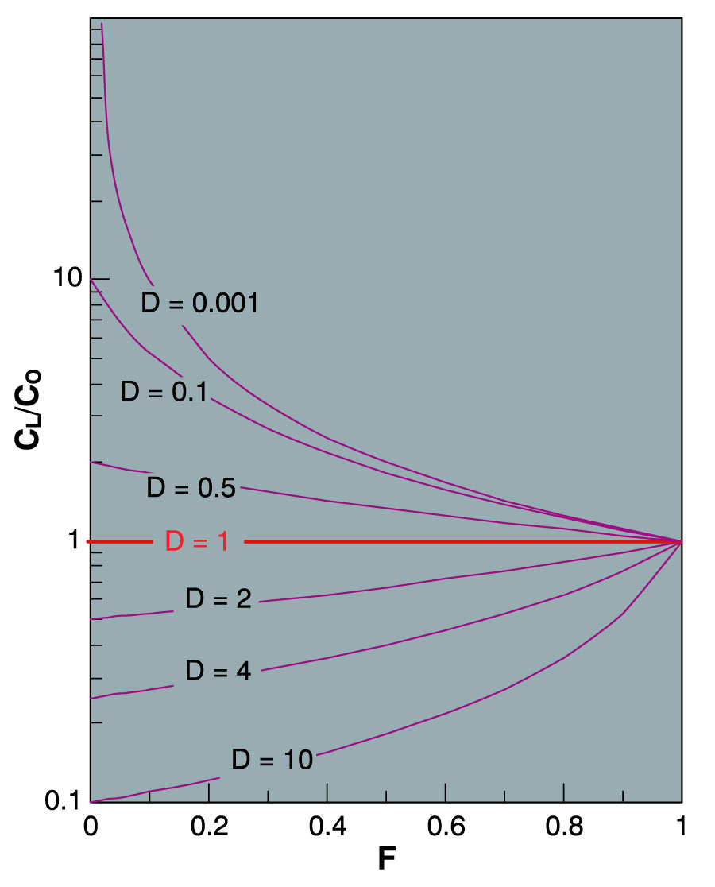
Batch Melting
A plot of C_{L}/C_{O} vs. F for various values of D_{i} using eq. 9-5
D_{i} = 1.0
Figure 9-2. Variation in the relative concentration of a trace element in a liquid vs. source rock as a fiunction of D and the fraction melted, using equation (9-5) for equilibrium batch melting. From Winter (2001) An Introduction to Igneous and Metamorphic Petrology. Prentice Hall.
Notes:
D = 1.0 No fractionation so C_{L}/C_{O} = 1 for all values of F

Slide 15
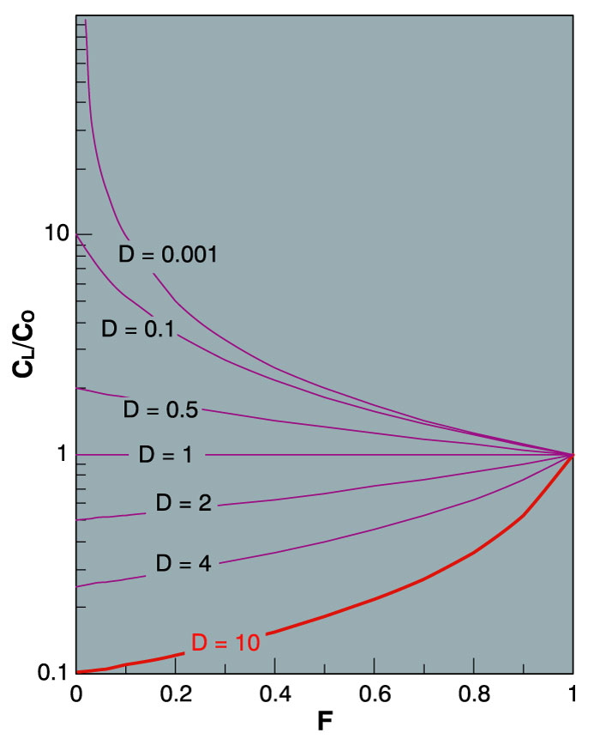
D_{i} » 1.0 (compatible element)
Very low concentration in melt
Especially for low % melting (low F)
Figure 9-2. Variation in the relative concentration of a trace element in a liquid vs. source rock as a fiunction of D and the fraction melted, using equation (9-5) for equilibrium batch melting. From Winter (2001) An Introduction to Igneous and Metamorphic Petrology. Prentice Hall.
Notes:
Values of F > 0.4 unlikely for batch melting since greater amounts should separate and rise

Slide 16
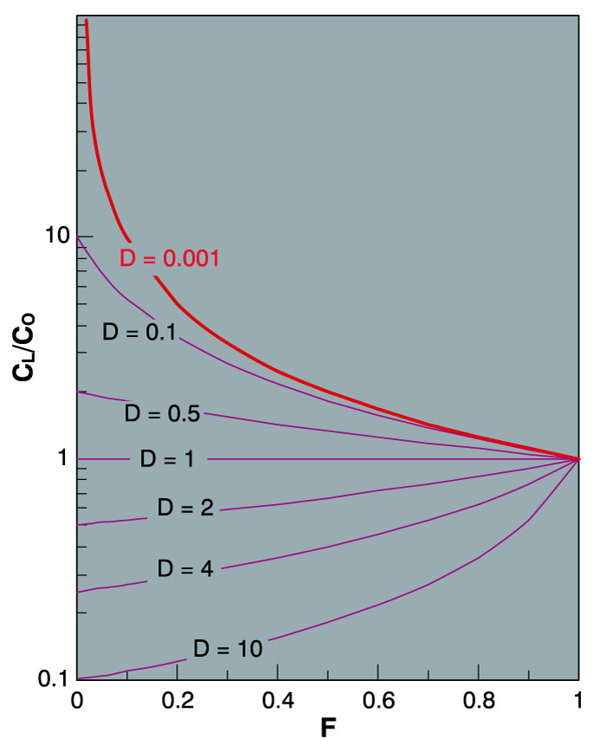
Highly incompatible elements
Greatly concentrated in the initial small fraction of melt produced by partial melting
Subsequently diluted as F increases
Figure 9-2. Variation in the relative concentration of a trace element in a liquid vs. source rock as a fiunction of D and the fraction melted, using equation (9-5) for equilibrium batch melting. From Winter (2001) An Introduction to Igneous and Metamorphic Petrology. Prentice Hall.
Notes:
Highly incompatible elements are greatly concentrated in the initial small fraction of melt that is produced by partial melting, and subsequently get diluted as F increases

Slide 17
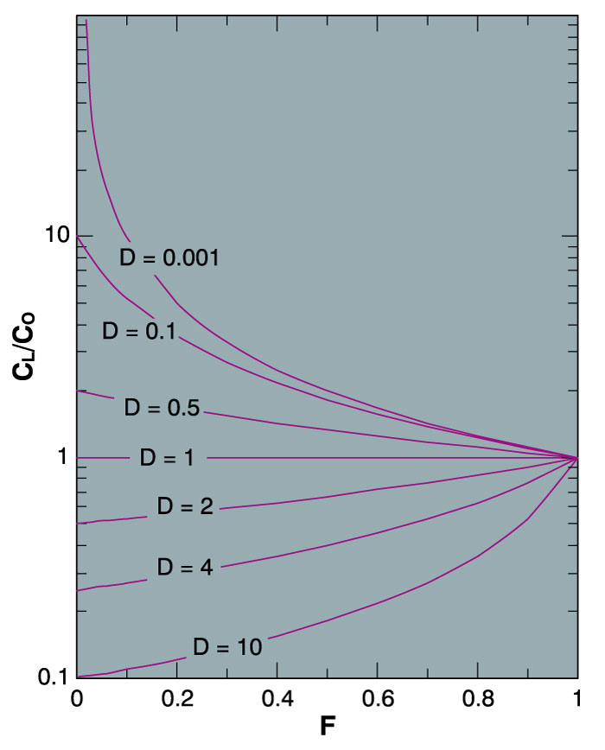
As F → 1 the concentration of every trace element in the liquid = the source rock (C_{L}/C_{O} → 1)
As F → 1
C_{L}/C_{O} → 1
C
1
L
=
C
D_{i}
(1
−
F)
+
F
O
Figure 9-2. Variation in the relative concentration of a trace element in a liquid vs. source rock as a fiunction of D and the fraction melted, using equation (9-5) for equilibrium batch melting. From Winter (2001) An Introduction to Igneous and Metamorphic Petrology. Prentice Hall.
Notes:
All -> 1.0 because all of the source is melted

Slide 18
Worked Example of Batch Melting: Rb and Sr
3. Use the batch melting equation
to calculate C_{L}/C_{O} for various values of F
Table 9-3
. Batch Fractionation Model for
Rb and Sr
C
L
/C
O
= 1/(D(1-F)+F)
D
Rb
D
Sr
F
0.045
0.848
Rb/Sr
0.05
9.35
1.14
8.19
0.1
6.49
1.13
5.73
0.15
4.98
1.12
4.43
0.2
4.03
1.12
3.61
0.3
2.92
1.10
2.66
0.4
2.29
1.08
2.11
0.5
1.89
1.07
1.76
0.6
1.60
1.05
1.52
0.7
1.39
1.04
1.34
0.8
1.23
1.03
1.20
0.9
1.10
1.01
1.09
From Winter (2001) An Introduction to Igneous and Metamorphic Petrology. Prentice Hall.

Slide 19
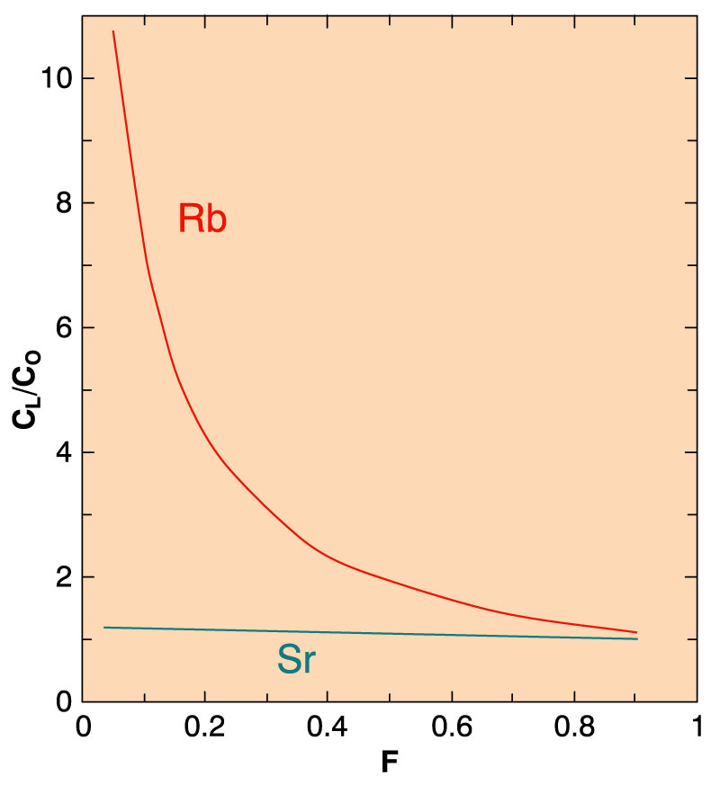
4. Plot C_{L}/C_{O} vs. F for each element
Figure 9-3. Change in the concentration of Rb and Sr in the melt derived by progressive batch melting of a basaltic rock consisting of plagioclase, augite, and olivine. From Winter (2001) An Introduction to Igneous and Metamorphic Petrology. Prentice Hall.
Notes:
Results:
Incompatible element Rb (no K minerals) strongly concentrated in the early small melt proportions (low F)
Thus → a sensitive measure of the progress of fractional crystallization (at least until rock half melted)
As melting proceeds, the incompatible element is gradually diluted by more compatible ones
Since D(Sr) is close to 1.0, the ratio Rb/Sr vs. F is nearly the same as Rb alone
Any ratio of incompatible to compatible element should then be sensitive to the degree of partial melting (at least in the initial stages).
Important for Rb/Sr isotopic systems
Note that can create a series of melts from a single source each with diff Rb/Sr

Slide 20
Source: Chemical Petrology II: Trace Elements (Principles of Igneous and Metamorphic Petrology John D. Winter)

Slide 21
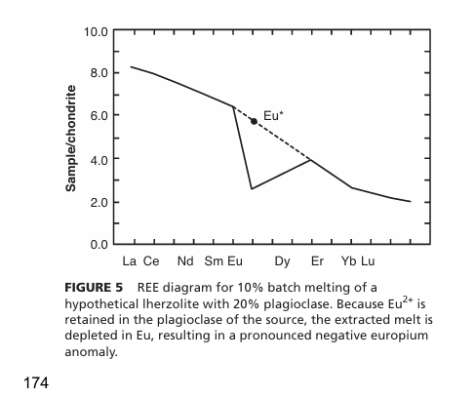
Europium anomaly
Europium anomaly: a plagioclase-bearing melt source
Eu is divalent in contrast with other REE’s which are trivalent.
Consequently it behaves like Sr
Source: From Winter (2001) An Introduction to Igneous and Metamorphic Petrology. Prentice Hall.

Slide 22
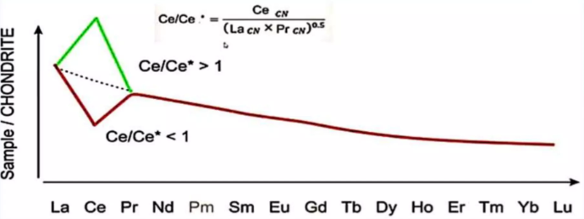
Cerium anomaly
Positive Ce Anomaly (Ce Enrichment)
Occurs in reducing environments, where Ce remains as Ce³⁺, which is more soluble and concentrated in the melt or fluid.
Negative Ce Anomaly (Ce Depletion)
Occurs in oxidizing environments where Ce³⁺ is oxidized to Ce⁴⁺, which is insoluble.

Slide 23
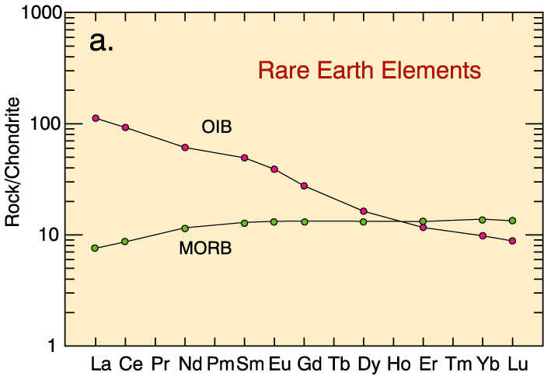
Rare Earth Elements as indicators of petrogenesis (melting source)
increasing incompatibility

Slide 24
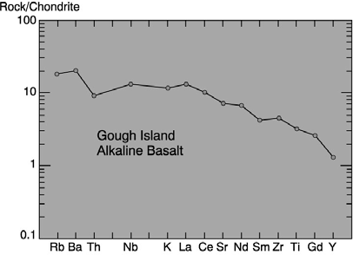
Spider Diagrams
An extension of the normalized REE technique to a broader spectrum of elements
Chondrite-normalized spider diagrams are commonly organized by of increasing incompatibility L ← R
Fig. 9-6. Spider diagram for an alkaline basalt from Gough Island, southern Atlantic. After Sun and MacDonough (1989). In A. D. Saunders and M. J. Norry (eds.), Magmatism in the Ocean Basins. Geol. Soc. London Spec. Publ., 42. pp. 313-345

Slide 25
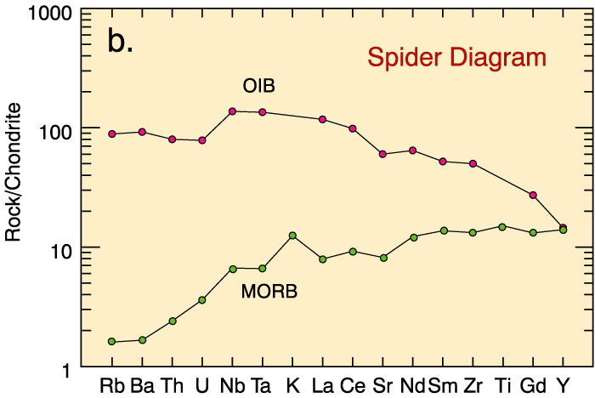
Spidergrams or Spider-diagrams
increasing incompatibility

Slide 26
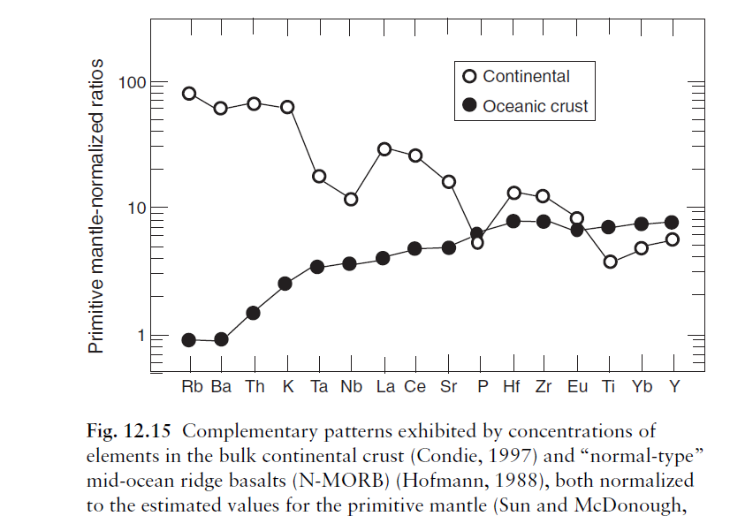

Slide 27
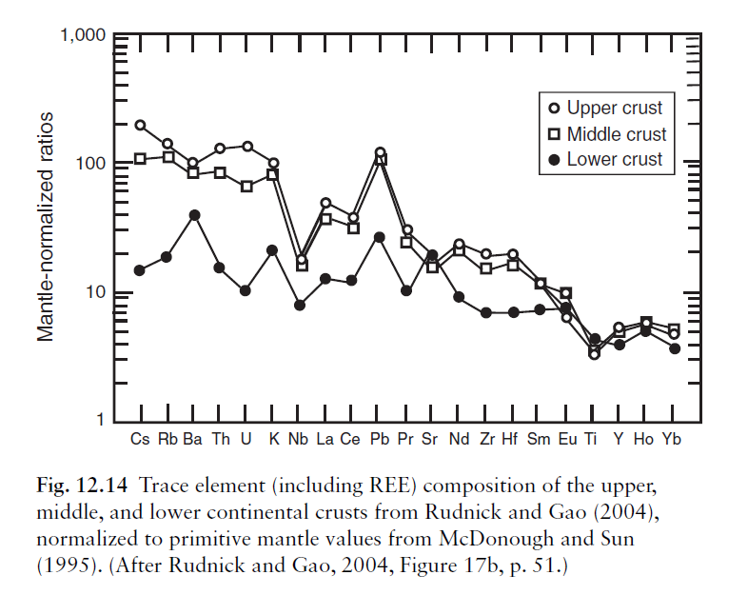

Slide 28
Geochemical evolution through time

Slide 29
Divisions of Geologic Tim13 e
Based on the fossil record, major changes in life forms occurred at certain times.
These changes were used to mark the boundaries between units of geologic time.
Divisions of the geologic time scale depend on significant events in the history of life on Earth.

Slide 30
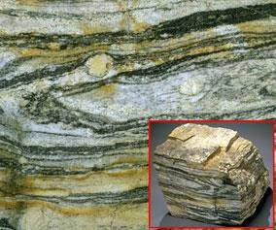
Age of the Earth
Earth:
Earth formed within 50 Myr of oldest meteorite components (CAI’s), which are 4,567.3 ± 0.12 Ma.
Accretion (incl. Moon) complete by 4.52 Ga.
Oldest minerals (zircons) from much younger sedimentary rocks in W. Australia:
4.30 Ga.
4) Oldest rocks: Acasta gneiss (NW Canada): 4.03 Ga.
Other rocks from Greenland, W. Australia, Antarctica, China, Wyoming are 3.80~3.96 Ga.

Slide 31
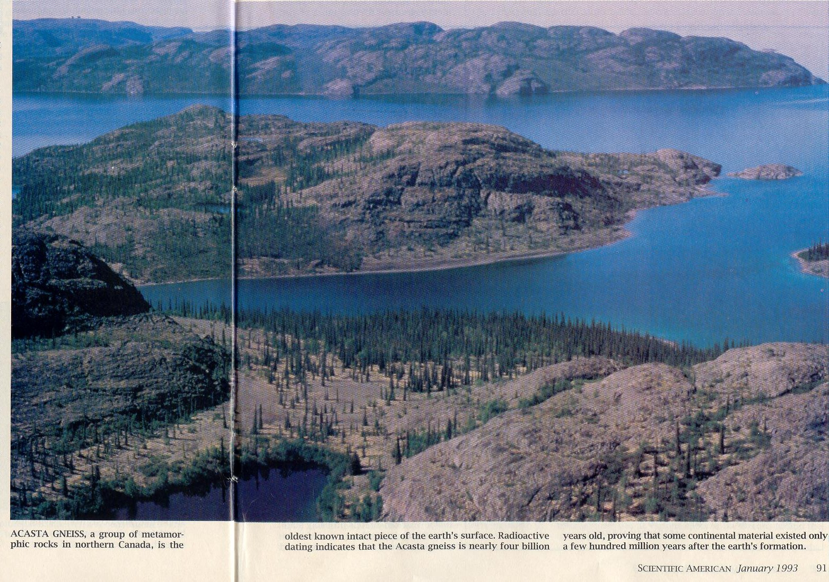
4.03 billion-year-old
Acasta Gneiss, NW Canada: oldest known intact piece of Earth’s surface

Slide 32
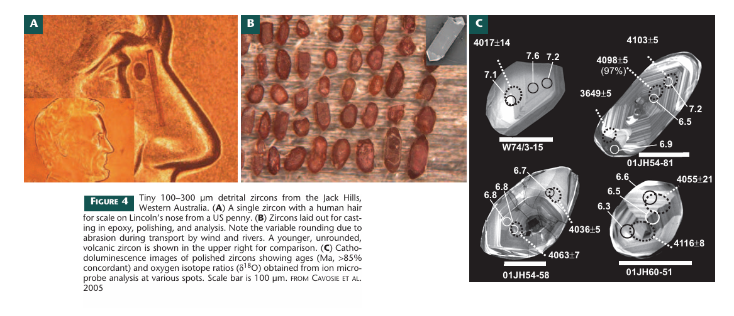
Valley (2006) Elements 2:201

Slide 33
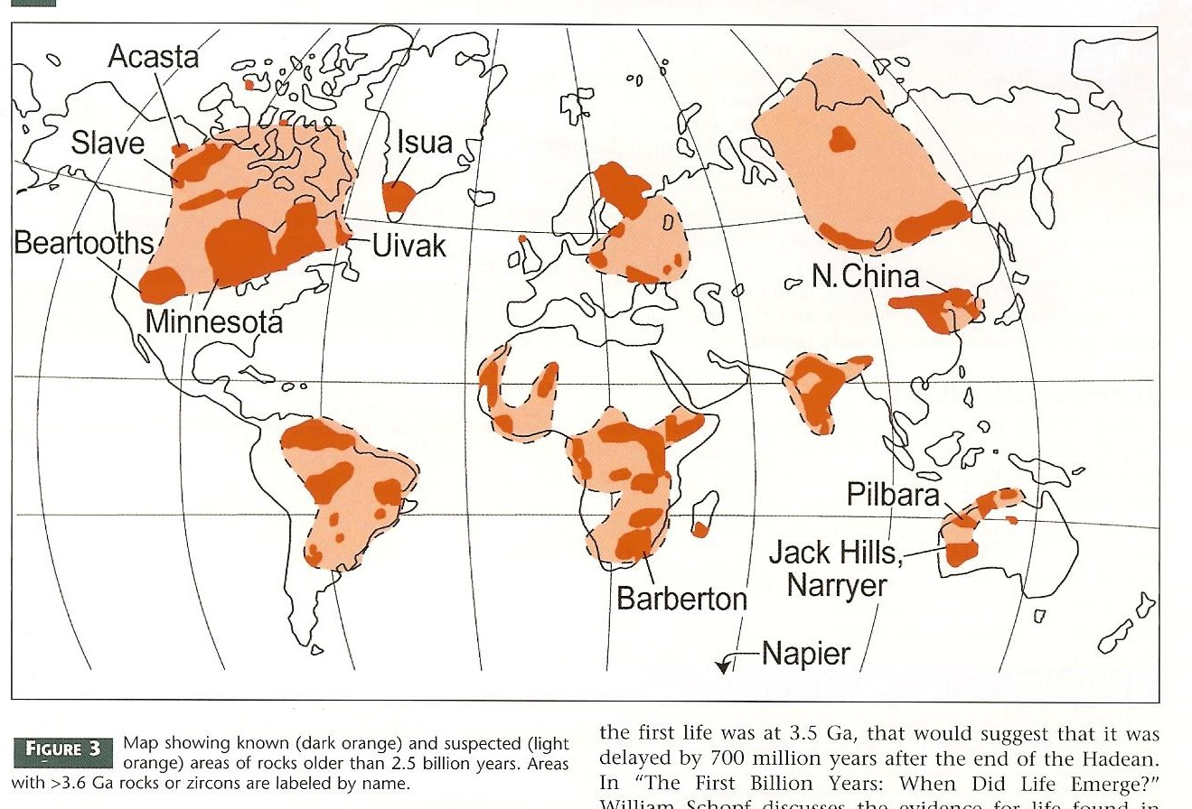
Rocks older than 2.5 Ga

Slide 34
Divisions of Time
14
▶ EON – largest division of geologic time
▶ ERA – 2nd largest, includes two or more periods
▶ PERIOD – 3rd largest, unit into which eras are divided
▶ EPOCH – 4th largest, the subdivision of a period EON > ERA > PERIOD > EPOCH

Slide 35
EONS
15
▶ Hadean – rocks from meteorites and moon
▶ Archean – earliest rocks on earth form “Greek word arkheios, meaning "ancient" or "beginning."
▶ Proterozoic – organisms with well developed cells “earlier life”
▶ Phanerozoic – means “visible life” well represented in the fossil record

Slide 36
Eons:
Precambrian: Earliest span of time
Phanerozoic: Everything since
Eras: Paleozoic Mesozoic Cenozoic
Periods: Cambrian Ordovician Silurian Devonian
Carboniferous
(Missipp. & Pennsylvanian)
Permian Triassic Jurassic Cretaceous Paleogene Neogene Quaternary
Paleozoic
“Age of
Invertebrates”
Epochs: Paleocene Eocene Oligocene
Mesozoic
“Age of Reptiles”
Cenozoic
“Age of Mammals”
Miocene
Pliocene
Pleistocene Holocene

Slide 37
ERAS
▶ Paleozoic – “early life”
544 → 244 mya
▶ Mesozoic – “middle life”
245 → 66 mya
▶ Cenozoic – “recent life” 66mya → present

Slide 38
